Slide 1
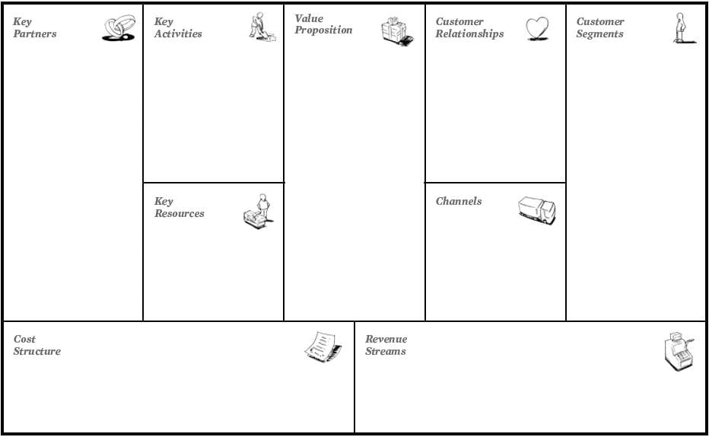
1-the doctors.
2- Advertisers
3- clinics.
1- Medical appointment booking service.
2-client management -mentor and client assignment and ongoing monitoring.
3-outreach - interaction with the clints.
1- high performance.
2- non existent service in aqaba.
3-convenience.
4-Promotional discounts.
1-trust.
2-caring.
3-continuous.
4-development.
1- People who are living in aqaba.
2- advertisers.
1-Social media.
2-marketing team.
3-word of mouth.
4-Distribution of brochures.
5. website.
1-capital.
2-Membership.
3-Team.
1-Advertisement.
2-Maintenance and development.
3-marketing team.
4-Office rental.
1-primary funding source from website revenues.
2-sponsors(secondary income).

